Slide 2
Restigouche County’s demographic challenge

Slide 3
New Brunswick is much older and aging faster than Canada
Source: Statistics Canada, CANSIM table 17-10-0005-01.

Slide 4
And Restigouche County is aging much faster than New Brunswick
Source: Statistics Canada, CANSIM table 17-10-0139-01.

Slide 5
Faster aging means slower growth!
New Brunswick lost workers over the past decade while Canada’s labour force continued to grow at a robust clip
As a result, New Brunswick economy has badly trailed behind Canada’s
The Campbellton-Miramichi lost 10% of its workers over the last decade, which suggests its economy likely shrank
Source: Statistics Canada, CANSIM tables 14-10-0023-01,14-10-0102-01 and 36-10-0402-02.
Note: Real GDP data not available for Restigouche County.

Slide 6
The labour market challenge: filling the gap left by retiring baby boomers
Up until the turn of the last decade, the number of young people reaching the official working age of 15 was well above that of people reaching the official retirement age of 65
In 2011, the first baby boomers turned 65 and the gap between those turning 15 and 65 began to widen dramatically
Without many more newcomers, Restigouche County's labour force will continue to shrink for at least another 10 years.
Source: Statistics Canada, CANSIM table 17-10-0139-01.

Slide 7
Migration has the potential to prevent the emptying out Restigouche County's schools
Newcomers to New Brunswick are typically of child-rearing age
Migration to Restigouche County seems to have contributed to stabilizing the school age population
The example of Moncton shows that migration can make a powerful contribution to boosting school age population
Source: Statistics Canada, CANSIM table 17-10-0139-01.

Slide 8
Serious labour market challenges remain
Population aging means greater demand for public services
As a result, labour is shifting from private to public sector
Many more workers will be needed to meet growing demand for public services and grow the private sector
Source: Statistics Canada, CANSIM table 14-10-0092-01.

Slide 9
Private sector growth will be critical to ensuring quality public services
Health care spending escalates dramatically as seniors grow older
New Brunswick’s first baby boomers are turning 75 this year. Over the next 15 years, the number of people aged 75 and over is projected to more than double, to nearly 140,000
This will result in escalating health care costs. Private sector growth is needed to cover escalating costs
Source: Calculations by Richard Saillant based on Canadian average provincial health spending by age group for 2017 and data from Canadian Institute for Health Information (CIHI) and Statistics Canada, CANSIM table 17-10-0057-01, high growth population scenario.

Slide 10
Permanent resident admissions by region around New Brunswick
The good news: Immigrants are moving into non-urban areas too
6,000
In 2017 only 360 immigrants settled outside of the seven urban centres in New Brunswick.
By 2019 nearly 1,100 did – a growth rate of nearly triple.
Covid-19 impacted the 2020 intake.
Restigouche attracted 63 immigrants in 2019/2020.
4,610
3,645
*intended destination. Source: IRCC

Slide 11
Population growth and K-12 education

Slide 12
Making the case for a plan: Growing the K-12 population
K-12 enrolment is declining across NB even as the demand for workers is rising.
Attracting more young families to the province will help rebuild the K-12 student population.
Ensuring the next generation has a larger local talent pipeline.
It’s already happening in Fredericton and Moncton.

Slide 13
Projecting K-12 enrolment
Assuming a significant increase in immigration

Slide 14
Restigouche County’s population growth projections

Slide 15
Why does the region need to grow its population?
Many strategically important industries
New growth opportunities
1,100 businesses
Risk that many would leave if workforce demand can’t be addressed

Slide 16
Restigouche County’s population growth forecasts 2020 to 2040
Three scenarios:
Developed using Statistics Canada population growth projections for New Brunswick* adjusted for demographic situation and trends specific to the county.
Scenario 1: Current population trajectory.
Scenario 2: Population growth needed to maintain the current size of the workforce.
Scenario 3: Population growth needed to expand the workforce at an annual average rate of 0.5%.
*Using Projection scenario HG: High-Growth

Slide 17
Restigouche County’s population growth forecasts 2020 to 2040
Why these three scenarios?
Scenario 1: Current population trajectory.
To show the current population trajectory if nothing changes.
Scenario 2: Population growth needed to maintain the current size of the workforce.
To show what level of population growth is needed just to keep the same workforce size.
Scenario 3: Population growth needed to expand the workforce at an annual average rate of 0.5%.
To show what level of population growth is needed if the county wants to grow its workforce in a moderate way.
*Using Projection scenario HG: High-Growth

Slide 18
Restigouche County’s population growth scenarios

Slide 19
Population Scenario: | Current trajectory
Projected outcome (2040): | Population decreases by 6% (-1,900). Workforce decreases by 32% (-4,500).
Potential implications: | Potential loss of export industries.
 | Increasing share of the workforce employed in local services (public and private). Some businesses might move to other larger urban centres to find workers.
 | Difficulties expanding new industries (agriculture, tourism, natural resources, etc.)

Slide 20
Population Scenario: | Maintain current size of the workforce (est. 59,400)
Projected outcome (2040): | Population must increase by 18% (+5,500). Workforce stays at 13,900. The county’s population grew at this rate in the 1970s.
Potential implications: | Increasing share of the workforce employed in local services (public and private).
 | Less workers for other industries – including export-focused industries.
 | Difficulties expanding new industries (agriculture, tourism, natural resources, etc.)

Slide 21
Population Scenario: | Grow the workforce at a modest 0.5% per year
Projected outcome (2040): | Population increases by 30% (+9,200). Workforce increases by +1,400. Would require a population growth rate not seen in decades.
Potential implications: | The region has the workforce to meet expected demand for local services.
 | … and the workforce to grow some new industries.

Slide 22
Restigouche County’s population growth forecasts 2020 to 2040 - Conclusions
If the county wants to maintain the current workforce size or expand it over the next 20 years, significant growth in the population is required.
Assuming other population growth components remain constant, it will require an increase in annual immigration from 63 in 2019/2020 to 400/year or more.
This will not happen by itself.
It will require a deliberate population growth plan for the region.
*Using Projection scenario HG: High-Growth

Slide 23
Restigouche County’s population growth plan

Slide 24
Local communities/regions need to get engaged.
This is not only a provincial government issue.
People and businesses move into local communities.
Economic opportunities occur in local communities.

Slide 25
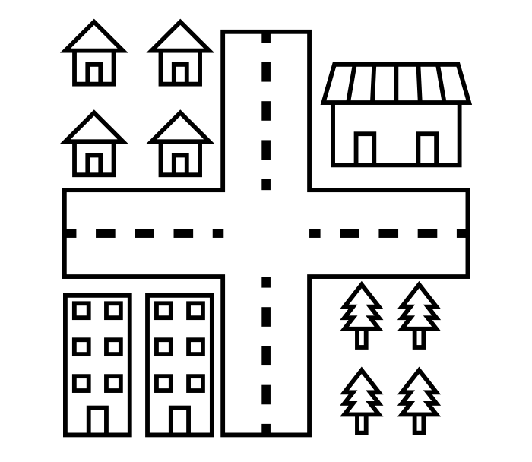
The changing demands on local/regional government
Local/regional government – circa 2000
Local/regional government – circa 2020

Slide 26
Not just a population growth plan, communities need a more comprehensive ‘business plan’
Elements of the business plan:
A clear understanding of labour market needs to support workforce exits and accommodate new growth.
Which industries have potential to grow in the future in the region?
What level of inward population migration do we need?
What are the barriers to attracting new population? (e.g. housing, local support infrastructure, language training, etc.)

Slide 27
Next Steps

