Slide 2
Kent County’s demographic challenge

Slide 3
New Brunswick is aging more and aging faster than Canada

Slide 4
And Kent County is aging faster than New Brunswick
Source: Statistics Canada, CANSIM tables 17-10-0005-01 and 17-10-0135-01.

Slide 5
The faster the population ages, the slower the economy
New Brunswick has lost workers in the past decade
As a result, its economic growth has been much lower than that of Canada as a whole.
Kent County appears to have lost a lot of workers, suggesting its economy may have contracted
Source: Statistics Canada, CANSIM tables 14-10-0023-01,14-10-0102-01 and 36-10-0402-02.
Note: Real GDP data is not available for Kent County.
* Data for the Moncton-Richibucto economic region, excluding the Moncton CMA.

Slide 6
The challenge: filling the void left by baby boomers
Until the turn of the decade, the number of people reaching official working age (15) exceeded that of those reaching official retirement age (65)
It is no longer the case. Without newcomers, Kent County's labor force is expected to continue to decline rapidly for at least another 15 years.
Source: Statistics Canada, CANSIM table 17-10-0139-01.

Slide 7
Immigration has a positive effect on the school-age population
New arrivals are typically of child-rearing age
Kent County has seen a noticeable improvement in its school-age population in recent years
However, the county lags behind large centers like Moncton.
Source: Statistics Canada, CANSIM table 17-10-0139-01.

Slide 8
Serious challenges await us
Aging leads to more demand for public services
Private sector employment is declining in the region
We need more people to meet the needs of the public sector and grow the private sector

Slide 9
Growth of the private sector is essential to that of the public sector
Health spending is increasing exponentially as our seniors age
Over the next 15 years, the number of people aged 75 and over is expected to double, to around 140,000
This will put enormous pressure on health care spending

Slide 10
Permanent resident admissions by region around New Brunswick
The good news: Immigrants are moving into non-urban areas
6,000
In 2017 only 360 immigrants settled outside of the seven urban centres in New Brunswick.
By 2019 nearly 1,100 did – a growth rate of nearly triple.
Covid-19 impacted the 2020 intake.
Kent County has attract approx. 180 per year since 2016.
4,610
3,645
*intended destination. Source: IRCC

Slide 11
Population growth and K-12 education

Slide 12
Making the case for a plan: Growing the K-12 population
K-12 enrolment is declining across NB even as the demand for workers is rising.
Attracting more young families to the province will help rebuild the K-12 student population.
Ensuring the next generation has a larger local talent pipeline.
It’s already happening in Fredericton and Moncton.

Slide 13
Projecting K-12 enrolment
Assuming a significant increase in immigration

Slide 14
Kent County’s population growth projections

Slide 15
Why does the county need to grow its population?
Many strategically important industries
New growth opportunities
Approx. 1,100 employers
Risk that many could leave if workforce demand can’t be addressed

Slide 16
Kent County population growth forecasts 2020 to 2040
Three scenarios:
Developed using Statistics Canada population growth projections for New Brunswick* adjusted for demographic situation and trends specific to Kent County.
Scenario 1: Current population trajectory.
Scenario 2: Population growth needed to maintain the current size of the workforce.
Scenario 3: Population growth needed to expand the workforce at an annual average rate of 0.5%.
*Using Projection scenario HG: High-Growth

Slide 17
Kent County population growth forecasts 2020 to 2040
Why these three scenarios?
Scenario 1: Current population trajectory.
To show what will happen to the workforce if the population does not grow.
Scenario 2: Population growth needed to maintain the current size of the workforce.
To show what level of population growth is needed just to keep the same workforce size.
Scenario 3: Population growth needed to expand the workforce at an annual average rate of 0.5%.
To show what level of population growth is needed if the county wants to grow its workforce to support the growth of new industries.
*Using Projection scenario HG: High-Growth

Slide 18
Kent County population growth scenarios

Slide 19
Population Scenario: | Current trajectory
Projected outcome (2040): | Population declines by 7%. Workforce declines by 20% (-3,400)
Potential implications: | Potential loss of export industries.
 | Increasing share of the workforce employed in local services (public and private). Some businesses might move to the Moncton region to find workers.
 | Difficulties expanding new industries (agriculture, tourism, natural resources, etc.)

Slide 20
Population Scenario: | Maintain current size of the workforce (est. 17,000)
Projected outcome (2040): | Population must increase by 14% (+4,300). Workforce stays at 17,000. The county’s population grew at this rate in the 1970s.
Potential implications: | Increasing share of the workforce employed in local services (public and private).
 | Less workers for other industries – including export-focused industries.
 | Difficulties expanding new industries (agriculture, tourism, natural resources, etc.)

Slide 21
Population Scenario: | Grow the workforce at a modest 0.5% per year
Projected outcome (2040): | Population increases by 25% (+7,700). Workforce increases by +2,000. Would require a population growth rate not seen in decades.
Potential implications: | The county has the workforce to meet expected demand for local services.
 | … and the workforce to grow some new industries.

Slide 22
Kent County population growth forecasts 2020 to 2040 - Conclusions
If the county wants to maintain the current workforce size or expand it over the next 20 years, significant growth in the population is required.
Assuming other population growth components remain constant, it will require an increase in annual immigration from around 60-70 per year to between 220-300/year.
This will not happen by itself.
It will require a deliberate population growth plan for the county.
*Using Projection scenario HG: High-Growth

Slide 23
Kent County’s population growth plan

Slide 24
Local communities/regions need to get engaged.
This is not only a provincial government issue.
People and businesses move into local communities.
Economic opportunities occur in local communities.

Slide 25
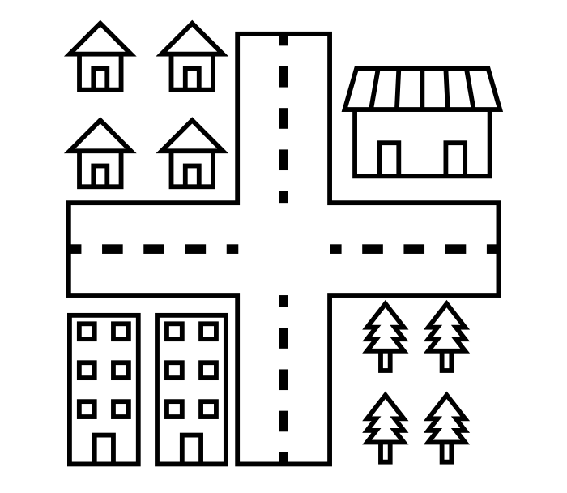
The changing demands on local/regional government
Local/regional government – circa 2000
Local/regional government – circa 2020

Slide 26
Not just a population growth plan, communities need a more comprehensive ‘business plan’
Elements of the business plan:
A clear understanding of labour market needs to support workforce exits and accommodate new growth.
Which industries have potential to grow in the future in the region?
What level of inward population migration do we need?
What are the barriers to attracting new population? (e.g. housing, local support infrastructure, language training, etc.)

Slide 27
Next Steps

