Slide 2
The Moncton Region’s demographic challenge

Slide 3
For the purposes of this report, population/demographic/industry data for the Moncton Census Metropolitan Area (CMA) area is used (also called the Moncton Region throughout the report). The Moncton CMA includes the cites of Moncton and Dieppe; the Town of Riverview; the villages of Dorchester, Hillsborough, Memramcook and Salisbury; and the parishes of Dorchester, Elgin, Hillsborough, Hopewell, Moncton and Saint-Paul.

Slide 4
New Brunswick is much older and aging faster than Canada
Source: Statistics Canada, CANSIM table 17-10-0005-01.

Slide 5
But Moncton is smartly bucking this trend
Moncton’s youth (0-14) has grown faster than Canada’s over the past decade
Its number of young working age adults has grown robustly, albeit somewhat slower than Canada’s
By contrast, the rest of New Brunswick has posted major declines
Source: Statistics Canada, CANSIM tables 17-10-0005-01 and 17-10-0135-01

Slide 6
Faster aging means slower growth!
New Brunswick lost workers over the past decade, while Canada’s labour force continued to grow at a robust clip
As a result, New Brunswick’s economy has badly trailed behind Canada’s
Not so in Moncton. Based on its solid labour force growth, the economy of the Moncton CMA likely performed similarly to Canada’s
Source: Statistics Canada, CANSIM tables 14-10-0023-01, 14-10-0096-01 and 36-10-0402-02.
*Real GDP data not available for Moncton CMA.

Slide 7
The labour market challenge: filling the gap left by retiring baby boomers
Up until 2011, the number of young people reaching the official working age of 15 was well above that of people reaching the official retirement age of 65
All this changed in 2011 when the county’s first boomers tured 65
Without newcomers, the labour force of the Moncton CMA would decline modestly over the next 10 years
Source: Statistics Canada, CANSIM table 17-10-0135-01.

Slide 8
Moncton’s school age population is booming
Newcomers to New Brunswick are typically of child-rearing age
Migration to New Brunswick has helped stablilize the school age population
In Moncton, it has led to a 16% increase over the last decade
Source: Statistics Canada, CANSIM tables 17-10-0135-01 and 17-10-0139-01.
.

Slide 9
Despite progress, serious labour market challenges remain
Public services are by far fastest growing sector
In private sector, industries catering to local/regional customers grew fastest since 2010
Other sectors are mostly flat since 2010; manufacturing and business service centres are down slightly
Source: Statistics Canada, CANSIM table 14-10-0098-01.

Slide 10
Private sector growth will be critical to ensuring quality public services
Health care spending escalates dramatically as seniors grow older
New Brunswick’s first baby boomers are turning 75 this year. Over the next 15 years, the number of people aged 75 and over is projected to more than double, to nearly 140,000
This will result in escalating health care costs. Private sector growth is needed to cover escalating cost
Source: Calculations by Richard Saillant based on Canadian average provincial health spending by age group for 2017 and data from Canadian Institute for Health Information (CIHI) and Statistics Canada, CANSIM table 17-10-0057-01, high growth population scenario.

Slide 11
Permanent resident admissions by region around New Brunswick
The good news: Immigrants are moving into non-urban areas too
6,000
In 2017 only 360 immigrants settled outside of the seven urban centres in New Brunswick.
By 2019 nearly 1,100 did – a growth rate of nearly triple.
Covid-19 impacted the 2020 intake.
The Moncton CMA has attracted an average of 1,400 immigrants per year over the past five years.
4,610
3,645
*intended destination. Source: IRCC

Slide 12
Population growth and K-12 education

Slide 13
Making the case for a plan: Growing the K-12 population
K-12 enrolment is declining across NB even as the demand for workers is rising.
Attracting more young families to the province will help rebuild the K-12 student population.
Ensuring the next generation has a larger local talent pipeline.
It’s already happening in Moncton and Moncton.

Slide 14
Projecting K-12 enrolment
Assuming a significant increase in immigration

Slide 15
The Moncton Region’s population growth projections

Slide 16
Why does the region need to grow its population?
Many strategically important industries
New growth opportunities
Over 5,000 current businesses
Risk that many would leave if workforce demand can’t be addressed

Slide 17
The Moncton Region’s population growth forecasts 2020 to 2040
Three scenarios:
Developed using Statistics Canada population growth projections for New Brunswick* adjusted for demographic situation and trends specific to the region.
Scenario 1: Current population trajectory.
Scenario 2: Population growth needed to maintain the current size of the workforce.
Scenario 3: Population growth needed to expand the workforce at an annual average rate of 0.5%.
*Using Projection scenario HG: High-Growth

Slide 18
The Moncton Region’s population growth forecasts 2020 to 2040
Why these three scenarios?
Scenario 1: Current population trajectory.
To show the current population trajectory for the Moncton CMA (spoiler alert – it’s real good).
Scenario 2: Population growth needed to maintain the current size of the workforce.
To show what level of population growth is needed just to keep the same workforce size.
Scenario 3: Population growth needed to expand the workforce at an annual average rate of 0.5%.
To show what level of population growth is needed if the region wants to grow its workforce in a moderate way.
*Using Projection scenario HG: High-Growth

Slide 19
The Moncton Region’s population growth scenarios

Slide 20
Population Scenario: | Current trajectory
Projected outcome (2040): | Population increases by 27% to 201,200. Workforce increases by 21% from 87,700 to 106,200.
Potential implications: | Strong increase in the workforce means much more potential growth in export-focused industries as well as locally focused industries.

Slide 21
Population Scenario: | Maintain current size of the workforce (est. 87,700)
Projected outcome (2040): | Population must increase by 9.9% (+15,800). Workforce stays at 87,700. Would represent a significant decline over the current forecasted growth rate (from 1.3% to 0.5% per year)
Potential implications: | Increasing share of the workforce employed in local services (public and private).
 | Less workers for other industries – including export-focused industries.
 | Difficulties expanding new industries (IT, tourism, other services, etc.)

Slide 22
Population Scenario: | Grow the workforce at a modest 0.5% per year
Projected outcome (2040): | Population increases by 18.3% (+29,100). Workforce increases by 8,700 to 96,400. Would require a pop. growth rate of 0.9% per year.
Potential implications: | The region has the workforce to meet expected demand for local services
 | … and the workforce to grow some new industries but not as much economic growth as the current trajectory.

Slide 23
The Moncton Region’s population growth forecasts 2020 to 2040 - Conclusions
Keep doing what you are doing – current course and speed.
Realize the region can expect less population growth from intraprovincial migration and natural population growth. Most population growth will come from attracting people from outside New Brunswick.
Ensure there is good housing options for people moving into the region.

Slide 24
The Moncton Region population growth plan

Slide 25
Local communities/regions need to get engaged.
This is not only a provincial government issue.
People and businesses move into local communities.
Economic opportunities occur in local communities.

Slide 26
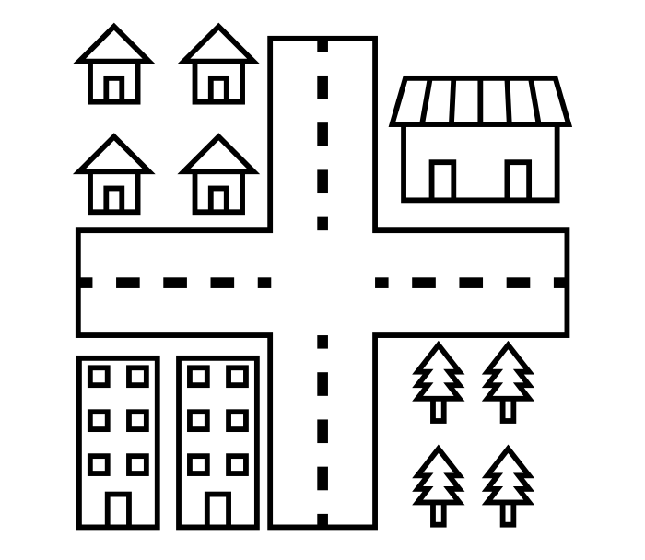
The changing demands on local/regional government
Local/regional government – circa 2000
Local/regional government – circa 2020

Slide 27
Not just a population growth plan, communities need a more comprehensive ‘business plan’
Elements of the business plan:
A clear understanding of labour market needs to support workforce exits and accommodate new growth.
Which industries have potential to grow in the future in the region?
What level of inward population migration do we need?
What are the barriers to attracting new population? (e.g. housing, local support infrastructure, language training, etc.)

Slide 28
Next Steps

